Slide 1
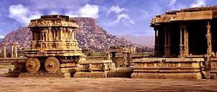
HISTORY OF INDIA
BA HISTORY PROGRAMME (ANNUAL) COURSES AS DISCIPLINE
“DCS ii (IA) HISTORY OF INDIA,FROM THE EARLIST TIMES UP TO C.300 CE “

Slide 2


SOURCE AND INTERPRETATION
Sources are important for the reconstruction of the past. Any remnant of the past can serve the purpose of a source. We have a variety of sources for reconstructing the history of ancient India. Broadly, they can be classified under the following main categories:
i) Literary,
ii) Archaeological,
iii) Foreign Accounts.
Under the literary sources can be included the Vedic, Buddhist and Jain literature, the Epics, Puranas, Sangam literature, ancient biographies, poetry and drama. Under the broad head of Archaeology, we may consider epigraphic, numismatic and architectural/archaeological remains that are recovered as the result of archaeological explorations and excavations

Slide 3
In Indian history there is a primacy accorded to the written records. However, archaeological artifacts in the form of temple remains, coins, house remains, post-holes, pottery, silos etc. also constitute an important category of evidence. For all the three periods of Indian history – ancient, medieval and modern – the archaeological evidence has acquired a lot of significance. It is indispensable for those periods which did not have any writing; for example, the prehistoric and proto-historic period of Indian history.
The sources can also be divided into primary and secondary. All archaeological artifacts recovered from the earth or written documents in the form of temple records; talapatra (palm-leaf manuscripts); inscriptions on palm leaves, pillars, rocks, copper plates, pot sherds etc. together constitute what are called the primary sources. These are used by the historians to write articles, books or any form of written history which are used by the subsequent researchers and are, hence, called the secondary sources.
The written primary sources are of two kinds:
i) Manuscript sources/ Inscriptions
ii) Published material.
One needs to be careful with all such records as one should find out the purpose behind them, what audience they were intended for, and, thus, accordingly proceed with caution

Slide 4
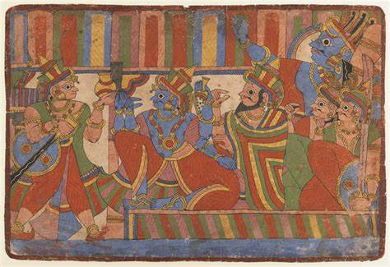
There are some crucial aspects which need to be taken care of when one is studying texts for historical information. Upinder Singh has pointed out that if the text was composed at a specific period than its use as a historical source is unproblematic. However, the exercise becomes much more complex if the composition extends over a long period of time. For example, in the case of the Indian Epic Mahabharata, it is difficult to bracket it as a text composed at a specific point of time. In such cases the historian has to sift through various chronological layers and look critically into various additions and interpolations. Language, style and content of a text have to be analyzed. In the case of both- Mahabharata and Ramayana, critical editions have been made where different manuscripts of these texts have been analyzed and an attempt has been made to identify their original core

Slide 5
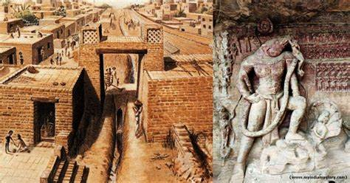
Certain questions have to be kept in mind while studying texts, for example, why were they composed? For whom? What was their social and cultural context? A text may represent an ideal and must not be taken as a description of what was actually happening at that time. A text, like so many of Indian religious texts, may contains myths which may have pointers to historical information, but should be studied with caution.

Slide 6

Literary Sources
Most of the early Indian literature contains much that deals with religion, theology, cosmology, cosmogony, magic, ritual, prayers and mythology. There are problems associated with dating these texts since their period of composition and compilation differ by a wide margin. As their subject matter is theology or religion, it is difficult to understand them historically. The Vedas, Upanishads, Brahamanas, Shastra literature, Epics and Puranas etc. deal broadly with non-secular themes. We will be studying these different categories of early Indian literature as sources of Indian history.
Vedas
The earliest known literature from the Indian subcontinent is in Sanskrit. The word veda is derived from the Sanskrit root ‘vid’ which means ‘to know’. Veda means knowledge. They are oral literature par excellence. They are traditionally regarded as ‘heard’ or revealed texts. The Vedic literature consists of three different classes of literary works which are

Slide 7
a) Samhitas or collections, namely collections of hymns, prayers, incantations, benedictions, sacrificial formulas and litanies. Four Samhitas are in existence which differ from each other:
Rigveda Samhita: The collection of the Rigveda. It is the veda or the knowledge of the songs of praise (ric).
Atharvaveda Samhita: The collection of the Atharvaveda or the knowledge of magical formulae (atharvan).
Samveda Samhita: The collection of the Samveda i.e. the knowledge of melodies (saman).
Yajurveda Samhita: The collection of the Yajurveda i.e. the knowledge of the sacrificial formulas (yajus).
b) Brahamanas: These are voluminous prose texts which contain theological matter, especially observations on sacrifice and the practical or mystical significance of the separate sacrificial rites and ceremonies
c) Aranyakas (forest texts) and Upanishads (secret doctrines): They contain the incantations of the forest hermits and ascetics on God, the world, mankind and contains a good deal of oldest Indian philosophy

Slide 8
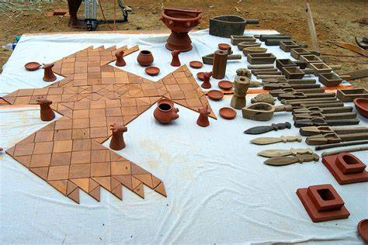
The whole Vedic literature is considered to have been revealed by God and therefore considered sacred. Chronologically, it spans a thousand years with some belonging to an earlier period and some portions to a later period. The Rigveda is the oldest and consists of ten books or mandalas. Books II-VII are the earliest
These are also called Family Books because each is ascribed by tradition to a particular family of rishis. When we refer to Early Vedic literature, we essentially refer to Books II -VII of the Rigveda, believed to have been composed between c. 1500-1000 BCE. The Later Vedic Literature includes Books I, VIII, IX and X of the Rigveda, Samveda, Yajurveda and Atharvaveda, Brahamanas, Aranyakas and Upanishads. These were composed between c. 1000 BCE to 500 BCE
Though most of the Vedic literature contains songs, prayers, theological and theosophical matter, these have been used by the historians to cull out political, religious and social data of much historical value. Information about processes like the transition from a pastoral, pre-class/caste society in the Rigveda to agrarian, class, caste society and the formations of political territories in the Later Vedic period has been obtained from these texts.

Slide 9
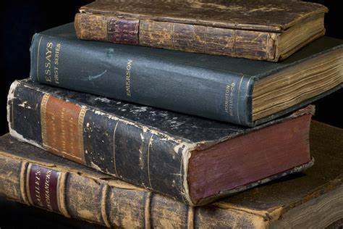
Then, there is a category of texts — the Sutras — which form part of the postVedic literature. These have been classified as ‘smriti’ or ‘memorized rather than heard’ (shruti) texts. The suggested meaning is that these were composed by humans — great sages — and as such, do not enjoy the sanctity of the Vedas though they are considered authoritative in their own right. The Sutra texts are manuals on ritual (c. 600-300 BCE). These include
Shrautasutra: contains rules for the performance of the great sacrifices.
b) Grihyasutra: contains directions for the simple ceremonies and sacrificial acts of daily life
c) Dharmasutra: These are books of instructions on spiritual and secular law. They are the oldest law books
Post-Sutra texts are the Smriti texts which are Manu Smriti, Narada Smriti and Yajnavalkya Smriti. These were composed between c. 200 BCE and 900 CE. They prescribe duties for different varnas as well as for kings and their officials. They set out rules for marriage and property. They also prescribe punishments for persons guilty of theft, assault, murder, adultery etc.

Slide 10
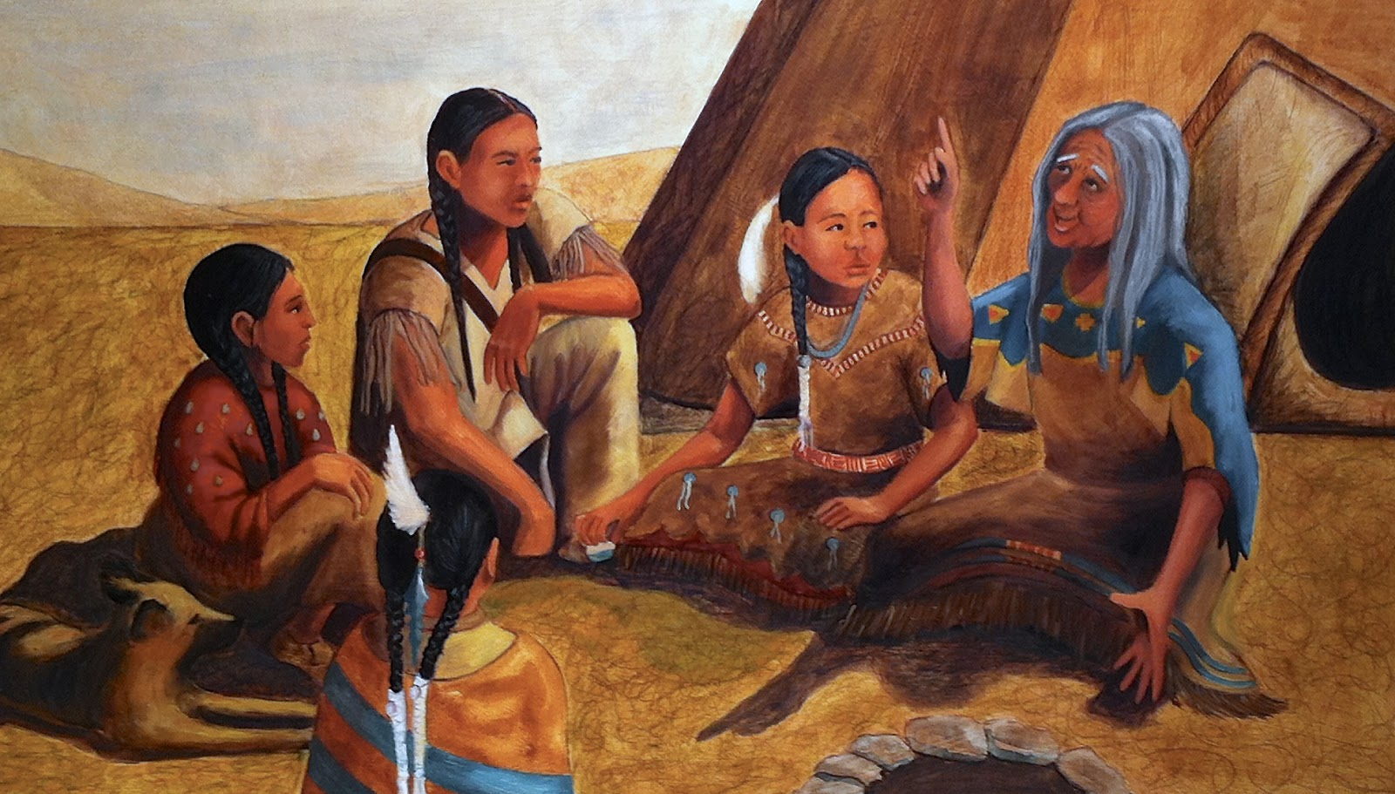
Oral and Written Tradition in Early India
A large portion of early Indian literature belongs to the oral tradition. The Vedas are traditionally regarded as Shruti i.e. ‘heard’ or revealed texts, words said to have been uttered by God Brahma in the ears of the first Man. They were handed down from one generation to the next with emphasis on memorization. Lotika Varadarajan feels that the process of memorization of the sacred texts obfuscated the vulgarization and corruption of the ritual utterances. This would have not been possible if these were transmitted through the written word. Knowledge was sacred and closed and only to be transmitted to a worthy student
The advent of literacy is associated with urbanization in India. The increase in trade and commerce coincided with the use of script and references abound about promissory notes, letters of credit, records of items produced and exchanged and even usury. The inscriptions were the greatest expressions of literacy. The Ashokan inscriptions dating to the third century BCE used the Brahmi script, the earliest evidence of the use of Brahmi. Romila Thapar remarks that what is true about Indian culture was that the oral and the written were closely integrated in cultural expression and written was not imposed on the oral tradition thus preventing it from becoming an alien feature

Slide 11
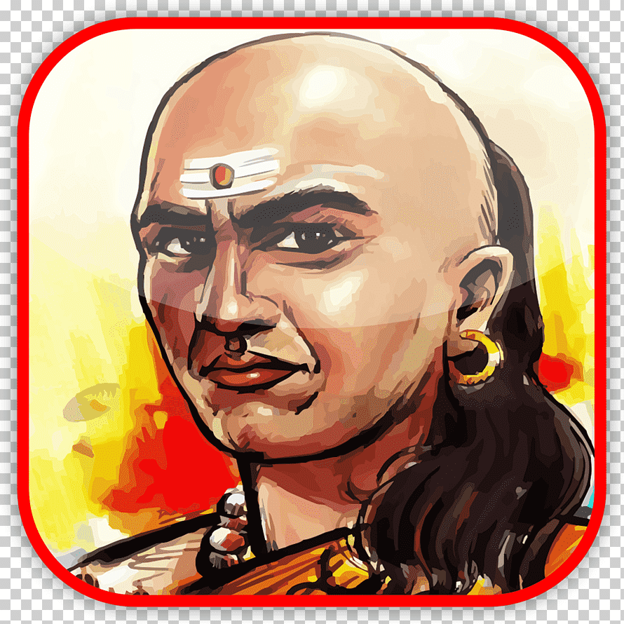
Kautilya’s Arthashastra
It is an important law book. The text is divided into fifteen books of which Book II and III may be regarded as being of an earlier date and seem to have been the work of different hands. It was put into final form in the beginning of the Common Era. However, the earliest portions reflect the state and society of the Mauryan period. It provides rich material for the study of early Indian polity and economy.

Slide 12
Ramayana and Mahabharata
The two famous Epics — Mahabharata and Ramayana — are known as Itihasa (‘thus it was’) or narratives. Both took many centuries to come into shape and the period roughly assigned to them is c. 500 BCE-500 CE. Vyasa’a Mahabharata is older and possibly reflects the state of affairs from the tenth century BCEfourth century CE. The main narrative which relates to the Kaurava-Pandava conflict may relate to the Later Vedic period; the descriptive portion might be post-Vedic and the didactic portions generally relate to post-Maurya and Gupta periods (Sharma, 2005). Since both Mahabharata and Ramayana contain interpolations and portions added at various points of time, historians have to be careful in sifting material. They also have to take into account different chronological layers. The Ramayana of Valmiki appears to be more unified than the Mahabharata. Some of the sites mentioned in the Ramayana and Mahabharata have been excavated. Ayodhya excavations have revealed settlement going back to the Northern Black Polished Ware period. Hastinapura, Kurukshetra, Panipat, Baghpat, Mathura, Tilpat and Bairat have been excavated and these date back to the Painted Grey Ware period. Both Epics are a mine of information on religious sects, how they were integrated into mainstream Hinduism, social practices and norms current at the time, and philosophy

Slide 13
Puranas
These are a category of texts attributed to Vyasa. There are eighteen Mahapuranas and numerous Upapuranas (secondary Puranas). The major Puranas were compiled by c. 400 CE. Their content indicates that these were the works of various hands. The Puranas has five sections- sarga (the creation of the world), pratisarga (re-creation), manvantaras (periods of the various Manus), vamsha (the genealogy of gods and rishis), and Vamshanucharita (an account of royal dynasties). Many Puranas like Vayu, Brahmanda, Brahma, Harivamsha, Matsya, Vishnu contain useful information for reconstructing the history of ancient India. As mentioned before, the Puranas contain considerable genealogical information. However, it is the later genealogies of the Kali Age that are historically important. There is much on ancient dynasties such as Haryankas, Shaishunagas, Nandas, Mauryas, Sungas, Kanvas and Andhras. Certain kings with their names ending in the suffix ‘naga’are also mentioned who supposedly ruled in northern and Central India. Interestingly, we do not know about these kings from any other source. The dynastic lists end with the Guptas indicating that the Puranas may have been compiled by fourth-sixth centuries CE. However, there are a few which are later such as Bhagvata Purana (tenth century) and Skanda Purana (fourteenth century).

Slide 14
Sangam Literature
The earliest Tamil texts are found in the corpus of Sangam literature. This is the work of poets who composed them over a period of three to four centuries. They assembled in colleges which were called Sangams and the literature produced in these colleges was called Sangam literature. There were three Sangams or literary gatherings — the first and last at Madurai and the second at Kapatapuram. This entire body of literature is dated to first four centuries of the Common Era, though they may have been completed by the sixth century. There is, however, some doubts about the historicity of these gatherings. Scholars, therefore, like to use the term “early classical Tamil literature” rather than Sangam literature (Singh, 2008)
Many poems mention a king or a hero by name and describe in detail his military exploits. The gifts made by him to bards and warriors are celebrated. May be, these poems were recited in the court. It is a possibility that the names of the kings refer to historical figures. Chola kings are mentioned as donors

Slide 15
Biographies, Poetry and Drama
Early India is a repository of masterpieces of drama and poetry. Historians have used them to cull out information on the times in which they were composed. The earliest Sanskrit poets and playwrights include Ashvagosha and Bhasa. Ashvagosha authored Buddhacharita, Sariputraprakarna and Saundarananda. Bhasa was a dramatist and wrote Pancharatra, Dutavakya, Balacarita and Svapna-Vasavadatta. The great Sanskrit writer Kalidasa (fourth-fifth centuries) authored dramas like Abhijnana-Shakuntalam, Malavikagnimitram, Vikramorvashiyam and poetic works such as Raghuvamsha, Kumarasambhavam and Meghadutam. They provide important insights into the social and cultural life of the Guptas. Then, there are ancient dramas on historical themes. Mention may be made of Vishakadatta’s Mudrarakshasa (seventh-eighth centuries). This drama is based on how Chanakya tries to win over Rakshasa, a minister of the Nandas, to Chandragupta Maurya’s side. His other play Devichandraguptam centres on an incident in Gupta king, Ramagupta’s reign.

Slide 16
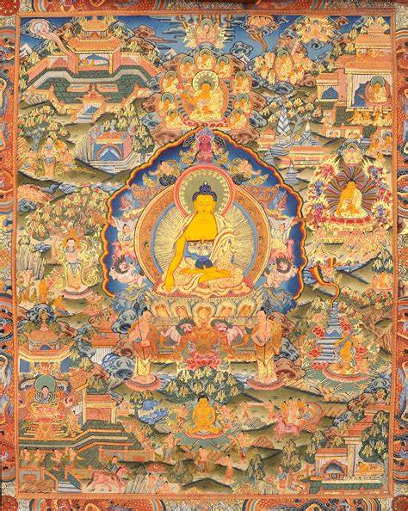
Buddhist and Jaina Literature
Among the non-Brahmanical and non-Sanskritic sources of early India, Buddhist and Jain literature constitute an important category. Said to have been composed after the death of the Buddha, the Pali texts Tripitakas or the ‘Three Baskets’ tell us about the state of affairs in India at the time of the Buddha and sixteen Mahajanapadas.Tripitakas is the common name which is given to the Buddhist canonical literature and their commentaries in Pali language. The Tripitikas are in Pali, Chinese and Tibetan versions. They consist of three books — the Sutta, Vinaya and Abhidhamma. The Sutta Pitaka contains the discourses of the Buddha on various doctrinal issues in stories, poems and dialogue form. The Vinaya is about the 227 rules and regulations for monks and nuns of the Sangha. It includes explanations about the founding of each rule by the Buddha. It contains information about the Buddha’s life, events and the story of Buddhism down to the first schism. It was written in 386 BCE. The Abhidhamma Pitaka (literally ‘higher Dhamma’) contains matter related to Buddhist philosophy in accordance with the Theravada school and contains lists, summaries and questions and answers. The Sutta Pitaka contains five Nikayas of which Khuddaka Nikaya is a collection of discourses. It contains Theragatha, Therigatha and Jatakas which are important sources for the historian. The Jatakas contain stories about the former births of the Buddha in the form of a deva, man, animal, fairy, spirit or a mythological character. Many stories and motifs were borrowed from preBuddhist and non-Buddhist oral vernacular traditions. Due to their popularity they were transformed into sculptural bas-reliefs at Bharhut, Sanchi, Nagarjunakonda and Amaravati. They are important as they provide a glimpse into the history of Buddhism and popular Buddhism

Slide 17
T h e r a g a t h a
(Verses of Elder Monks) and Therigatha (Verses of the Elder Nuns) are a collection of poems with verses which were narrated by the early members of the Buddhist Sangha. Therigatha is the first surviving poetry supposed to have been composed by women in India. Hence, it is important for not only Buddhism but also gender studies. The gathas of the Therigatha strongly support the view that women are equal to men in terms of spiritual attainment.
Jaina literature constitutes another important category of texts which are in a form of Prakrit called Ardha Magadhi. The literature of the Digambaras is in Jaina Sauraseni while Shvetambara literature is in two dialects of Ardha Magadhi. Mahavira’s teachings to his disciples were first compiled in 14 Purvas. In the fourth century BCE Sthulabhadra convened a great council at Pataliputra and reconstructed the Jaina canon in 12 Angas. Later in the fifth century CE at a council at Valabhi, the existing texts were formalized and presented in written form. The scriptures accepted by the Shvetambaras are- 12 Angas, 12 Upangas, 10 Prakirnas, 6 Chedasutras, 2 Sutras, 4 Mulasutras. These texts deal with code of conduct, various legends, Jaina doctrines and metaphysics. The Digambaras believe that most of the original Purvas are lost. Hence, the Digambaras do not accept the scriptures accepted by the Shvetambaras. The Digambaras use the scriptures written by great Acharyas but based on the original teachings of Mahavira for their religious practices. We can use the Jaina literature for information on history and doctrine of Jainism, doctrines of rival schools, the life stories of the saints and life of the monks in the sangha

Slide 18
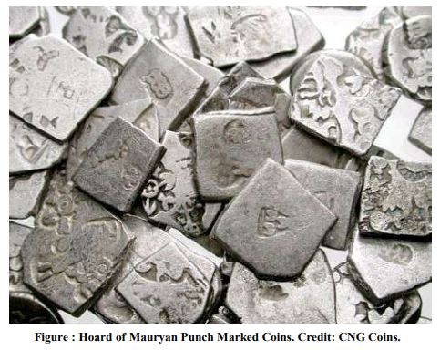
Archaeology
Archaeology is a branch of knowledge that studies material culture to understand the past. It has a close relation to history. Sculptures, pottery remains, bone fragments, house remains, temple remnants, coins, seals, inscriptions, floral remains like charred grains, ancient pollen and spores etc. constitute material culture that forms the subject matter of archaeology.
It is the archaeological evidence that has permitted us to study the prehistoric period. In India, even proto-historic period has been reconstructed on the basis of archaeology. However, we cannot limit the usefulness of archaeology to these periods alone; it is significant even for those periods which have written evidence, and which fall in the sphere of history proper. For example, the history of the Indo-Greeks has been reconstructed solely on the basis of coins.

Slide 19
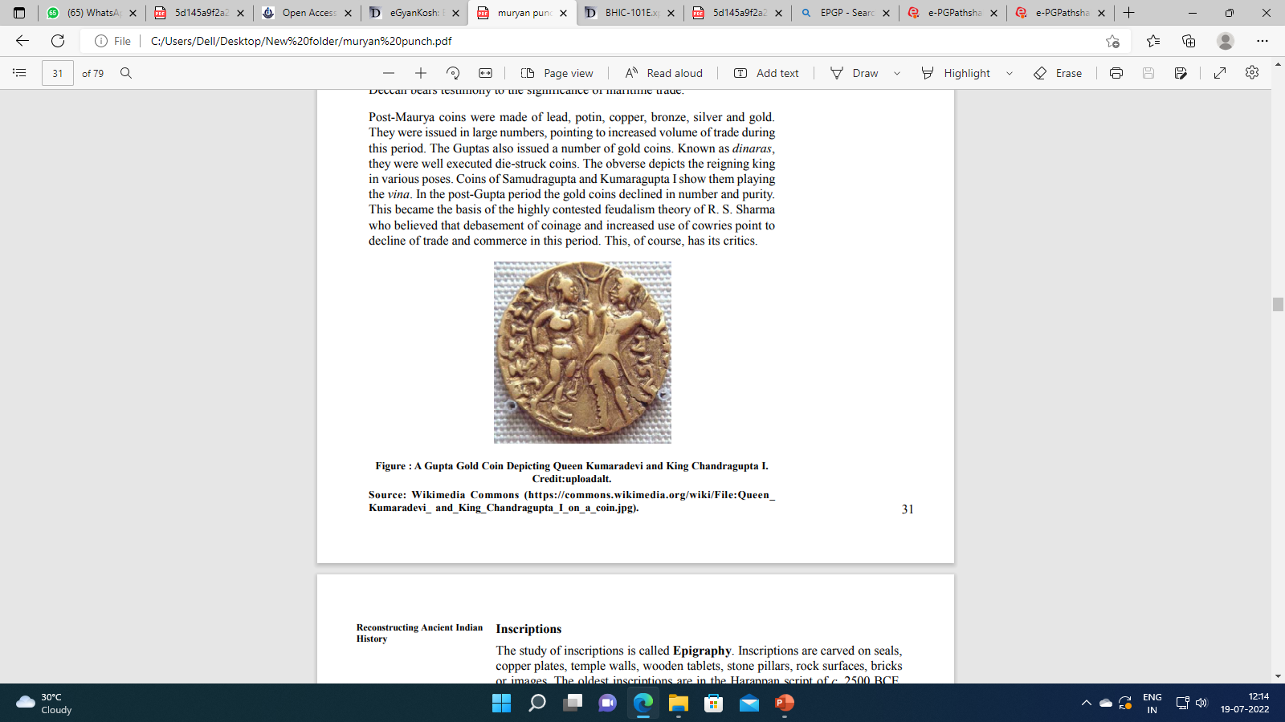
Coins
Coins have been found either in excavations as archaeological finds or as hoards. The study of coins is called Numismatics. Coinage is metal currency and has a definite shape, size and weight standard. It also bears the stamp of the issuing authority. The side of the coin which carries the message is called obverse and the opposite side is reverse. The ‘Second Urbanization’ in the early Indian history is the first instance where we find literary and archaeological evidence of coinage. This was the time of the emergence of States, growth of towns and cities, and spread of agriculture and trade. Coins in early India were made of copper, silver, gold and lead. Coin moulds made of burnt clay, dating to the Kushana period (first three centuries of the Common Era), have been found in hundreds. They point to the increased commerce during this time

Slide 20
Post-Maurya coins were made of lead, potin, copper, bronze, silver and gold. They were issued in large numbers, pointing to increased volume of trade during this period. The Guptas also issued a number of gold coins. Known as dinaras, they were well executed die-struck coins. The obverse depicts the reigning king in various poses. Coins of Samudragupta and Kumaragupta I show them playing the vina. In the post-Gupta period the gold coins declined in number and purity. This became the basis of the highly contested feudalism theory of R. S. Sharma who believed that debasement of coinage and increased use of cowries point to decline of trade and commerce in this period. This, of course, has its critics.
Most of the coins belonging to major dynasties have been catalogued and published. The earliest coins in the subcontinent are Punch Marked Coins. These are mostly of silver and sometimes of copper. With the expansion of Magadhan empire, the Magadhan type of Punch marked coins replaced those which were issued by other states. Though the earliest coins carried only symbols, the later ones had figures of king, divinities and also mention their dates and names. For example, Western Kshatrapa coins give dates in Shaka era.

Slide 21
Inscriptions
The study of inscriptions is called Epigraphy. Inscriptions are carved on seals, copper plates, temple walls, wooden tablets, stone pillars, rock surfaces, bricks or images. The oldest inscriptions are in the Harappan script of c. 2500 BCE, which is still un-deciphered. The earliest deciphered inscriptions are the Ashokan inscriptions which have been found on rock surfaces and stone pillars all through the subcontinent. These epigraphs were first deciphered in 1837 by James Princep, a civil servant in the employ of the East India Company in Bengal. Most of these are in Brahmi and Kharosthi script. Ashokan inscriptions are in a fairly developed script and it is assumed that writing must have existed in the earlier period too. Potsherds with short inscriptions have been found in excavations at Anuradhapura in Sri Lanka which can be dated to pre-Mauryan period of fourth century BCE. The first pure Sanskrit inscriptions appeared in first century BCE. The early inscriptions were a mixture of Prakrit and Sanskrit which by the fifth century CE were replaced by Sanskrit as the language of royal inscriptions.

Slide 22
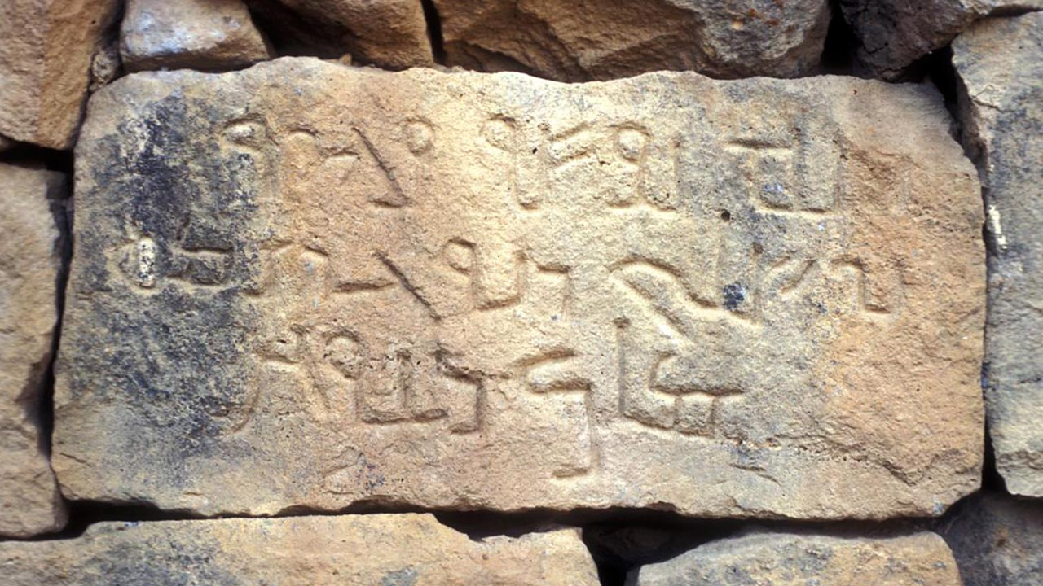
Inscriptions are a good source of political, social and economic history. They are valuable tools for the historian as they tell us about contemporary events and about the common people. The spread of inscriptions is taken as an indicator of the reigning king’s domain. Many inscriptions contain useful information about genealogy, dynastic details and sometimes, names of even those kings who have been missed out in the main genealogies. Land grants of the Pallava, Chalukya and Chola period inform us about revenue systems, agricultural details and political structures.
Inscriptions have many more uses, for example, they help us to date the sculptures on which they occur; give us information about extinct religious sects like the Ajivikas; tell us about historical geography; history of iconography; art and architecture; history of literature and languages; and even performing arts like music. They are more reliable than the literary texts as they are not always religious in nature

Slide 23

Foreign Accounts
Many travellers came to India as pilgrims, traders, settlers, soldiers, and ambassadors. They have left behind accounts of places they visited and things they saw. If studied with due caution, these accounts give a lot of valuable information,
The Greek writers mention Sandrokottas who is said to have met Alexander as a young man. In the eighteenth century, William Jones identified Sandrokottas with Chandragupta Maurya which formed the basis of Mauryan chronology. Seleucus’s envoy, Megasthenes, wrote the Indica, an account of his stay at the court of Chandragupta Maurya where he was the Greek ambassador. Though this text is no longer there, subsequent writers refer to certain portions of it and it has been possible to reconstruct the administrative structure, social classes and economic activities of the Mauryan period. Greek and Roman accounts give useful information about the Indian Ocean trade in early India. The Periplus of the Erythrean Sea (80-115 CE) and Ptolemy’s Geography (150 CE), both written in Greek, give information about geography and ancient trade. Early Greek and Latin works by Strabo, Arrian, Pliny the Elder tell us about Oceanic trade.

Slide 24
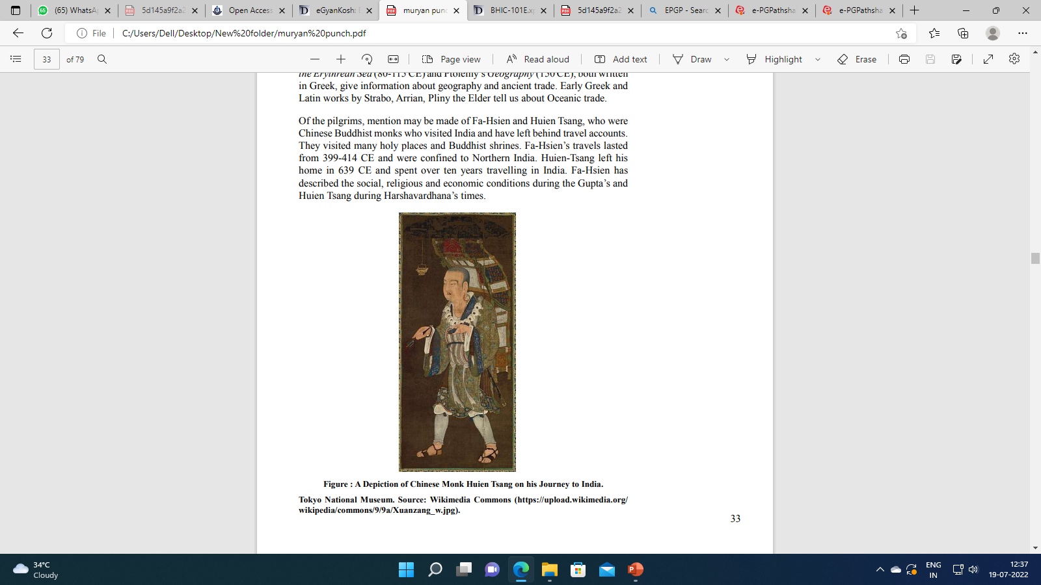
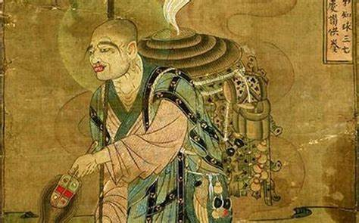
Of the pilgrims, mention may be made of Fa-Hsien and Huien Tsang, who were Chinese Buddhist monks who visited India and have left behind travel accounts. They visited many holy places and Buddhist shrines. Fa-Hsien’s travels lasted from 399-414 CE and were confined to Northern India. Huien-Tsang left his home in 639 CE and spent over ten years travelling in India. Fa-Hsien has described the social, religious and economic conditions during the Gupta’s and Huien Tsang during Harshavardhana’s times.

Slide 25
S U M M A R Y
The Himalayas in the north and the ocean in the south, south-west and southeast create a superficial view of the isolation of the Indian sub-continent. Cultural influences have been exchanged across these frontiers and there have been maritime contacts with the west, West Asia and Southeast Asia. Internally, even the rugged, difficult terrain of Central India has not really impeded the movement of ideas and influences between the varied regions of the country. Admittedly, geography and environment influence historical development considerably, even if they do not determine it entirely.
Inscriptions tell us a lot about historical events which occurred at a specific time and place. However, inscriptions and literary texts mostly represent the voice of the elite — the kings, brahmanas, court poets etc. Here archaeological sources come to the rescue. They may voice the sentiments of what the common folks felt, saw and lived. Excavations, particularly, are a useful source. Still, we need to study archaeological evidence in relation to literary evidence. Many a times if we juxtapose these two categories of evidence, we find that each corrects and substantiates the other and a more complete picture can be arrived at

